Slide 1
Question: Are all the states running similar number of tests?
Conclusions:
Some states like NY, CA, FL are running more tests than the rest of the country and so can be assumed to be aggressively testing for COVID19
Limitations:
Total tests are not normalized to the population of each state

Slide 2
Question: What percentage of the tested population is positive for COVID19? Is the percentage similar across the different states?
Conclusions:
Average percentage of positive cases across the US is 12.78%
20 states have a rate higher than the national average: NJ, NY, MP, MI, CT, GA, MA, IL, CO, PA
Calculation
(Positive cases / total tests)*100

Slide 3
These states might have high infection rates or they employ strict testing criteria – only if you meet certain criteria are you tested leading to a higher number of cases being positive
“Paranoia” states
Relaxed testing criteria
Limitations:
Possible correlation between the total number of tests done in these states

Slide 5
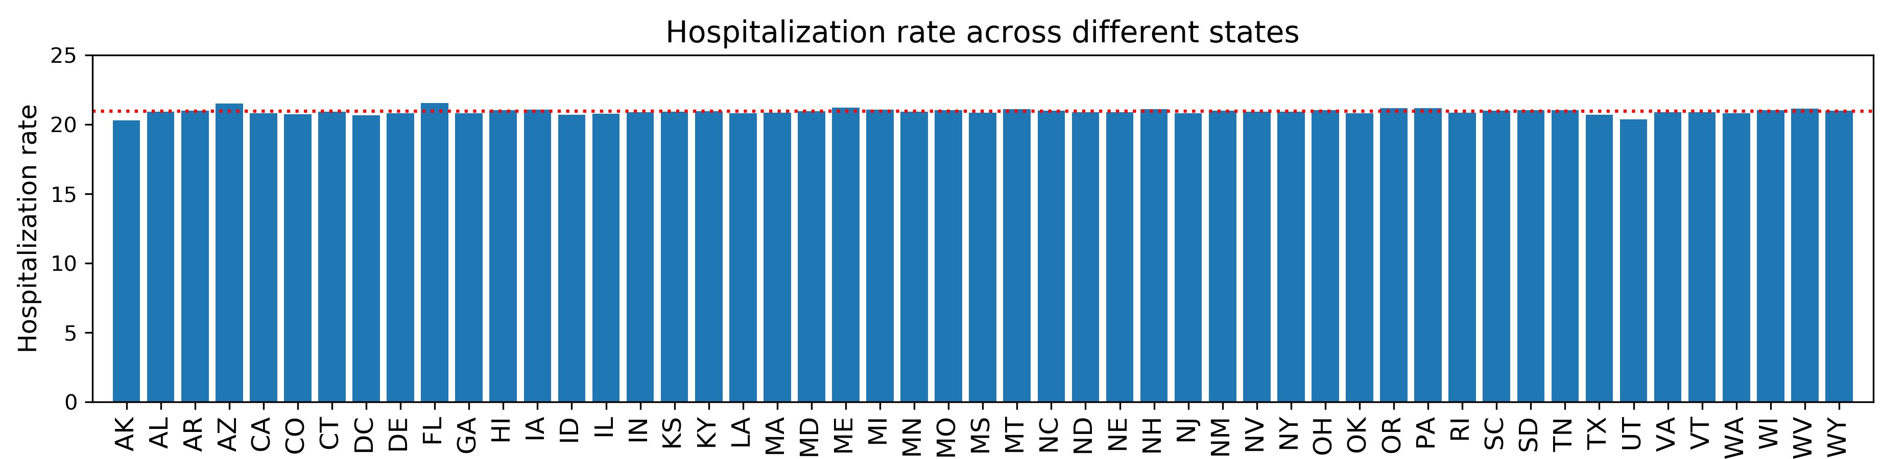
Question: Are the projected hospitalization rates different between states?
Conclusions:
No difference in the projected hospitalization rates
Calculation
(Projected Hospitalized Individuals / Projected Infected Individuals)*100

Slide 6
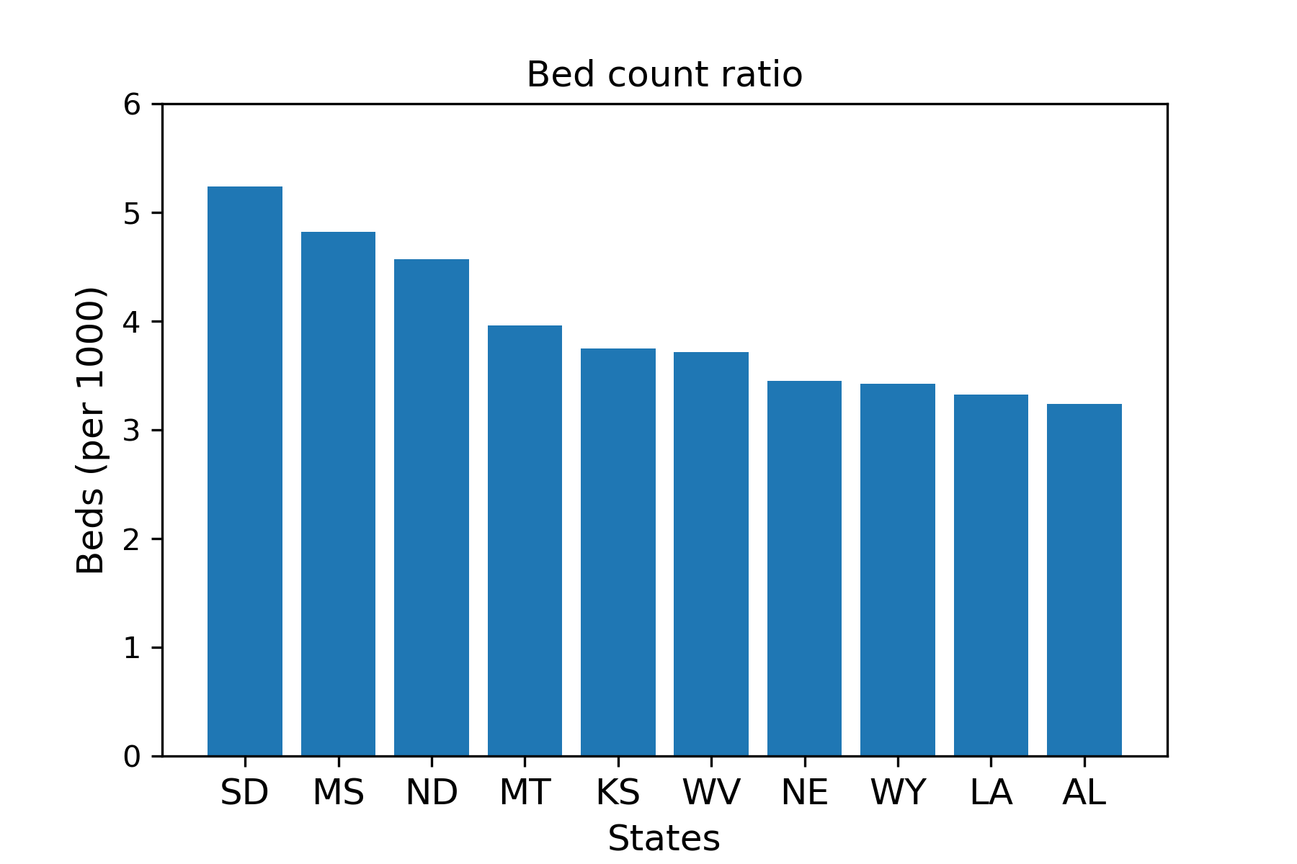
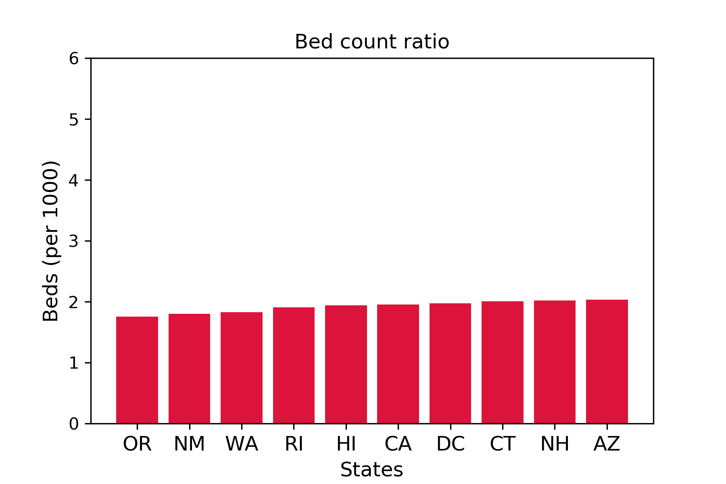
Question: Which states are better prepared with respect to bed counts considering the projected hospitalization rates are similar?
Conclusion:
SD has about 5 beds for every 1000 individuals whereas OR only has 2 beds for every 1000 individuals
IL is in the middle averaging about 2.59 beds for every 1000 individuals
Calculation
(Total bed counts / Total population)*1000

Slide 7
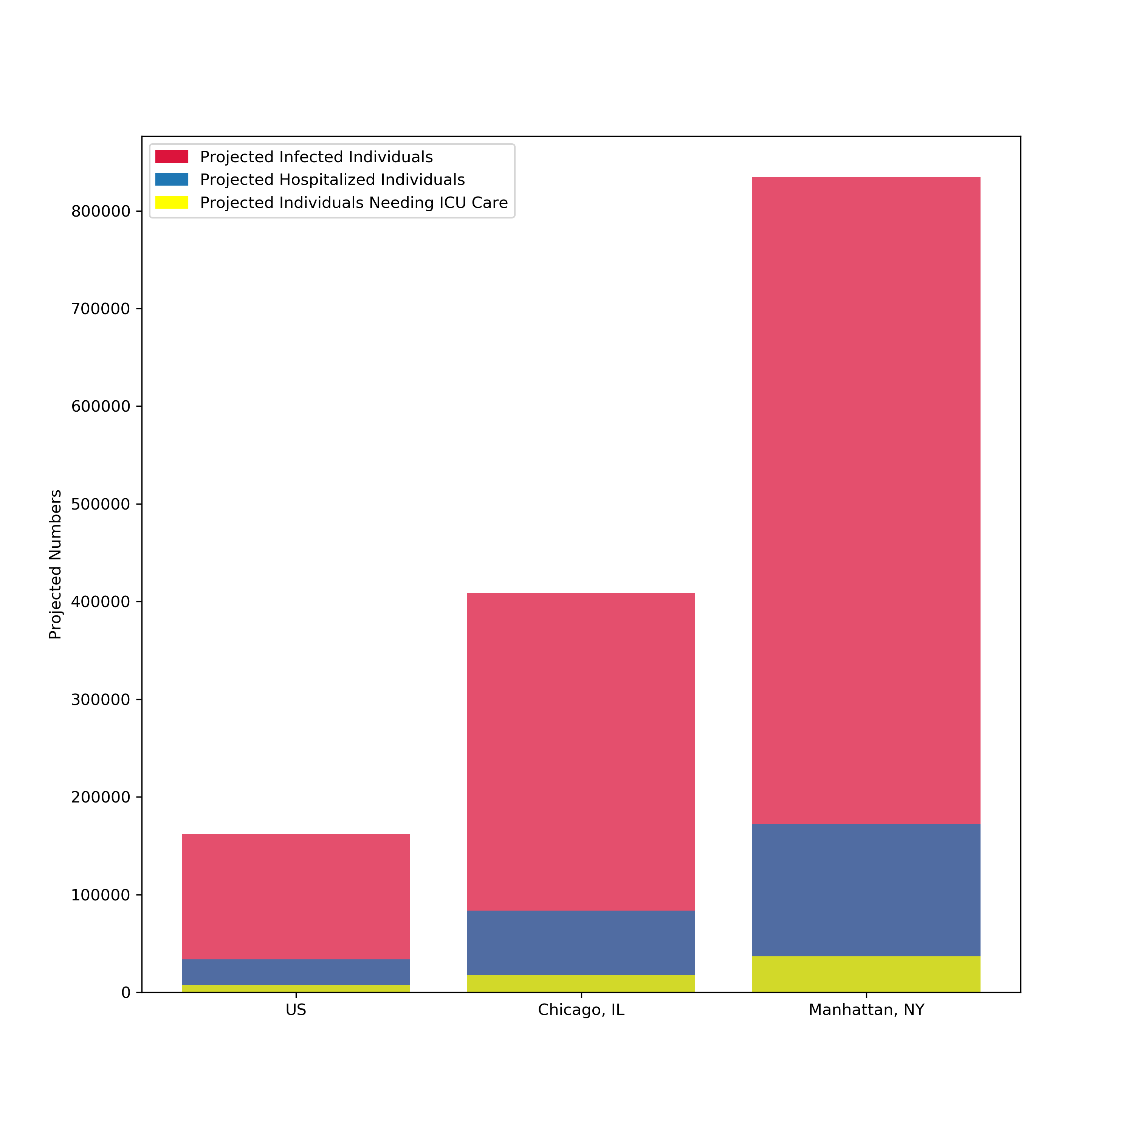
Question: How does Chicago fare with respect to projected number with the rest of the US?
Conclusion:
Chicago is projected to be worse than the rest of the US but still looks to be better than Manhattan in the 6-month projections

Slide 8
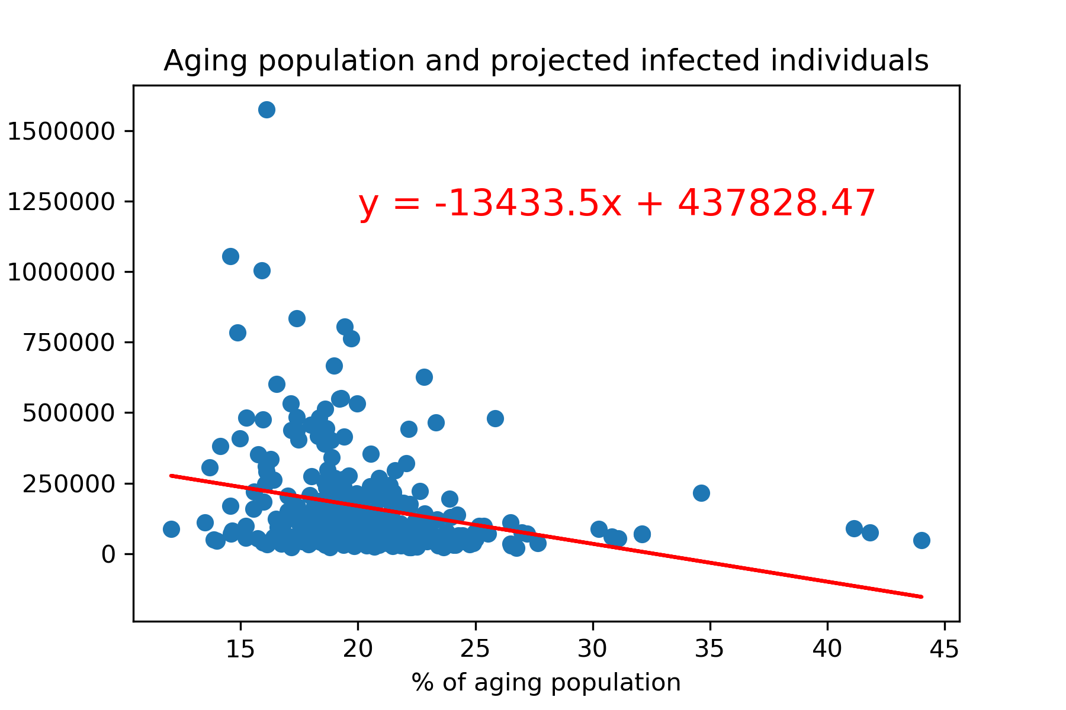
Question: Is there a correlation between infection and age?
Conclusion:
There is no correlation between age and susceptibility to infection which suggests that the youths need to exercise caution
Calculation
(Number of 65+ people/ Total population)*100

